Slide 1
MVC (model-view-controller)

Slide 2
What is MVC ?
Model-View-Controller (MVC) is a software architectural pattern that separates an application into three main components: the model, the view, and the controller.
This pattern helps to organize code in a way that segregates the application's data, user interface, and control logic into different sections, making it easier to manage and maintain.

Slide 3
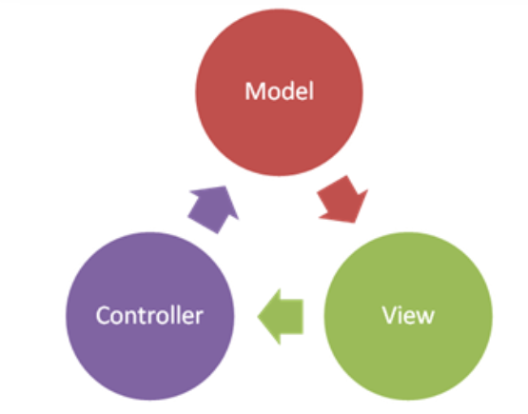
Components of MVC :
The MVC framework includes the following 3 components:
Controller
Model
View

Slide 4
Controller:
The controller is the component that enables the interconnection between the views and the model so it acts as an intermediary.
View:
The View component is used for all the UI logic of the application. It generates a user interface for the user.
Model:
The Model component corresponds to all the data-related logic that the user works with. This can represent either the data that is being transferred between the View and Controller components or any other business logic-related data.

Slide 5
Features of MVC
It provides a clear separation of business logic, UI logic, and input logic.
It supports Test Driven Development (TDD).
URL Control
Scalability
Reusability
It is also used for designing mobile apps.

Slide 6
MVC LIFE CYCLE
The MVC (Model-View-Controller) framework in ASP.NET follows a well-defined life cycle that describes how an HTTP request is processed and a response is generated.
Routing: Determines which controller and action should handle the request based on the URL.
Controller Initialization: Creates the controller instance and resolves dependencies if configured.
Action Execution: Invokes the action method, processes request parameters, and interacts with the model.
Result Execution: Executes the action result to generate an HTTP response.
View Engine: If returning a ViewResult, processes the view file to generate HTML.
Layout and Rendering: Combines view with layout (_Layout.cshtml) and sends HTML response to client.
Response: Client receives and renders the HTML content.

Slide 7
IActionResult in MVC
IActionResult is an abstract class in ASP.NET MVC that represents the result of an action method. It serves as the base class for different types of action results that an action method can return. The primary purpose of IActionResult is to encapsulate what will be rendered to the browser or client after an action method executes.
Types of IActionResult
ViewResult
PartialViewResult
RedirectResult
JsonResult
FileResult
ContentResult

Slide 8
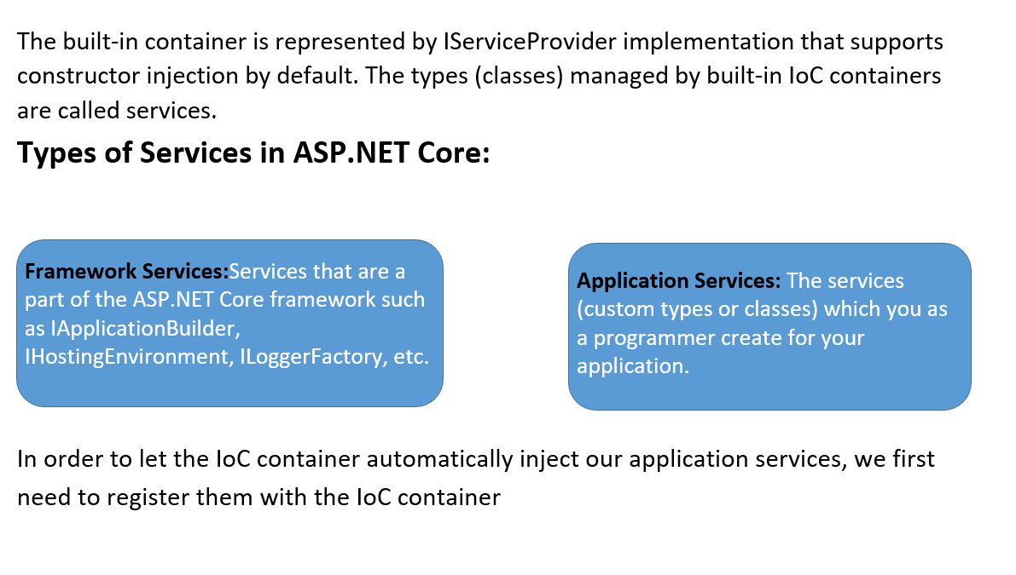

Slide 9
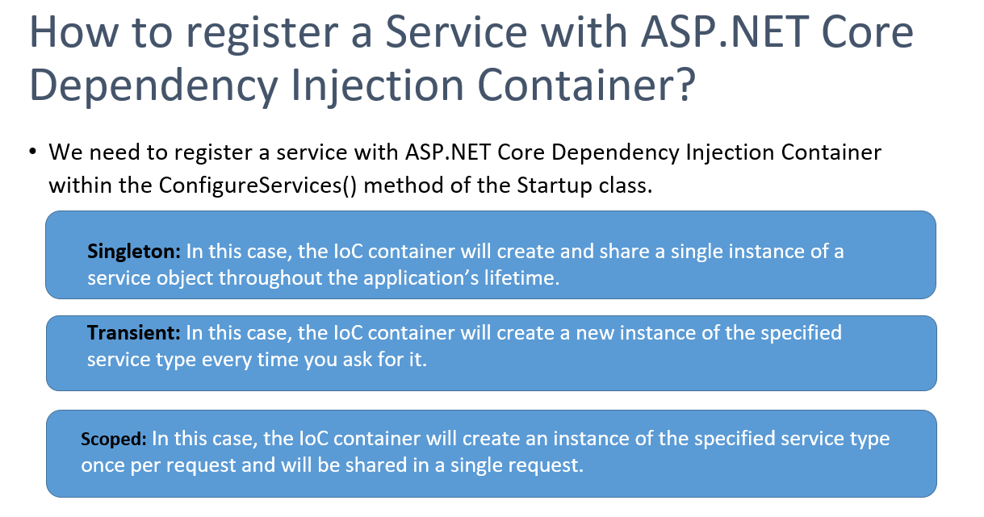

Slide 10
Advantages of MVC:
Codes are easy to maintain and they can be extended easily.
The MVC model component can be tested separately.
The components of MVC can be developed simultaneously.
It reduces complexity by dividing an application into three units. Model, view, and controller.
This architecture helps to test components independently as all classes and objects are independent of each other
Search Engine Optimization (SEO) Friendly.

Slide 11
Disadvantages of MVC:
It is difficult to read, change, test, and reuse this model
It is not suitable for building small applications.
The inefficiency of data access in view.
The framework navigation can be complex as it introduces new layers of abstraction which requires users to adapt to the decomposition criteria of MVC.
Increased complexity and Inefficiency of data

Slide 12
THANK YOU…..

